Slide 1
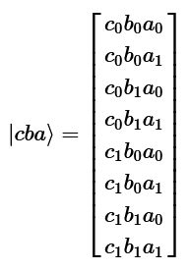
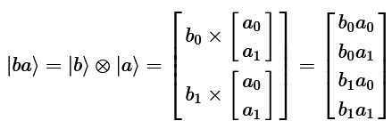

Kronecker or Tensor Product
If there are two or more separated qubits, it is possible to describe their collective state using the Kronecker product.

Slide 2
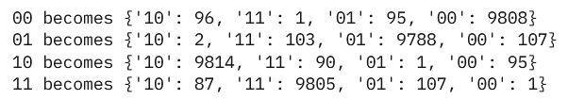
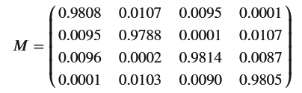
Error mitigation with linear algebra
If for a quantum circuit of two qubits you obtain the following measurements for every combination of two qubits,
you can build a measurements error matrix M:

Slide 3


Measurement Error Mitigation
Consider a simple model of the noise in the measurement process carried out on a quantum circuit, such that is possible imagining that the measurement first select the outputs in a perfect and noiseless manner, and then noise (Matrix M) subsequently causes the perfect output to be randomly perturbed before it is returned to the user.
So:

Slide 4
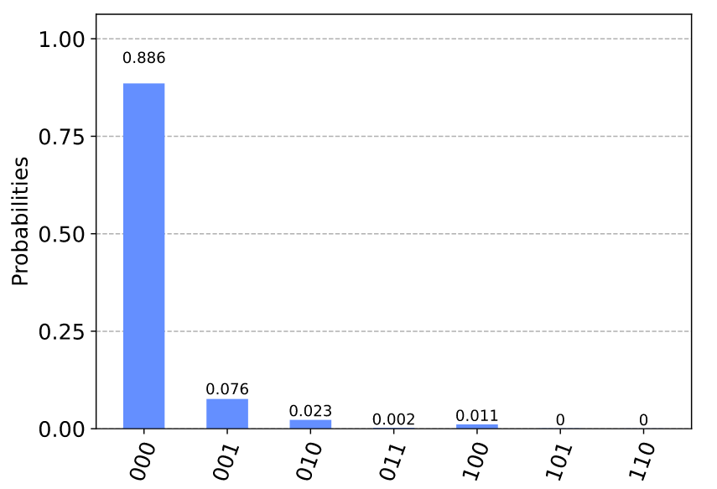
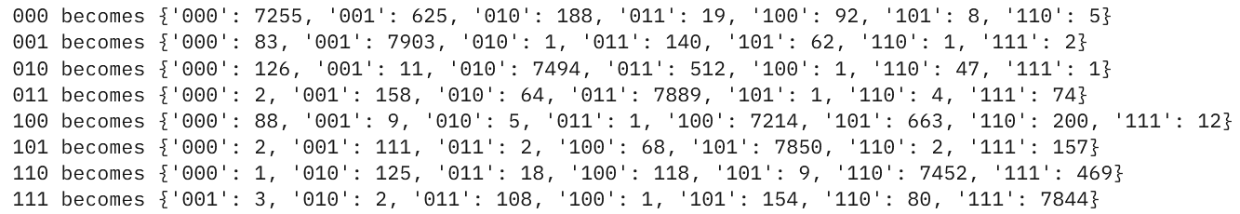
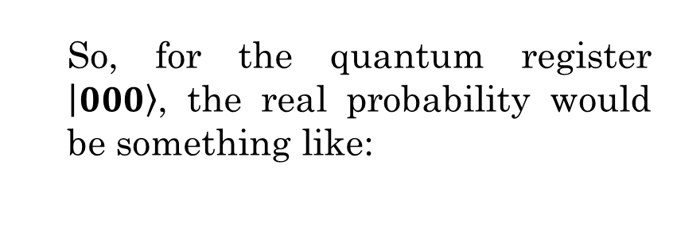
Measurement Error Mitigation (…cont)
If for a quantum circuit of three qubits we obtain the following measurements for every combination of three qubits:
So, for the quantum register $\left.\left|000\right.\right\rangle$, the real probability would be something like:
Execution for 8192 shots on the ibm_oslo quantum processor.

Slide 5
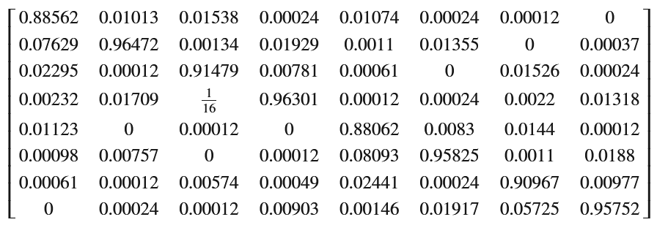
Measurement Error Mitigation (…cont)
So, the measurements error matrix M would be:
With M =

Slide 6
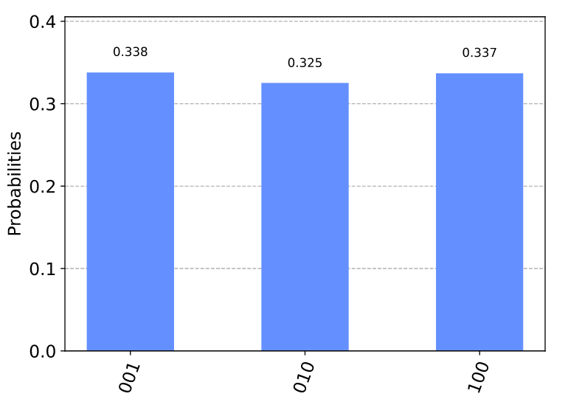
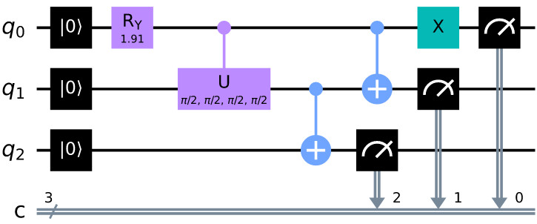
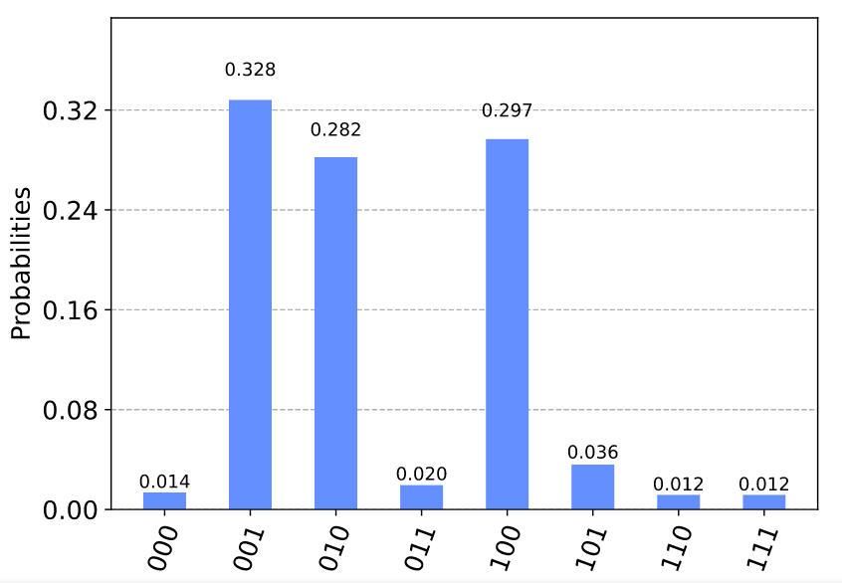
Analyzing the W-State Quantum Circuit
Results on Simulation
W state - quantum entangled circuit
Results on a Real Quantum Processor

Slide 7
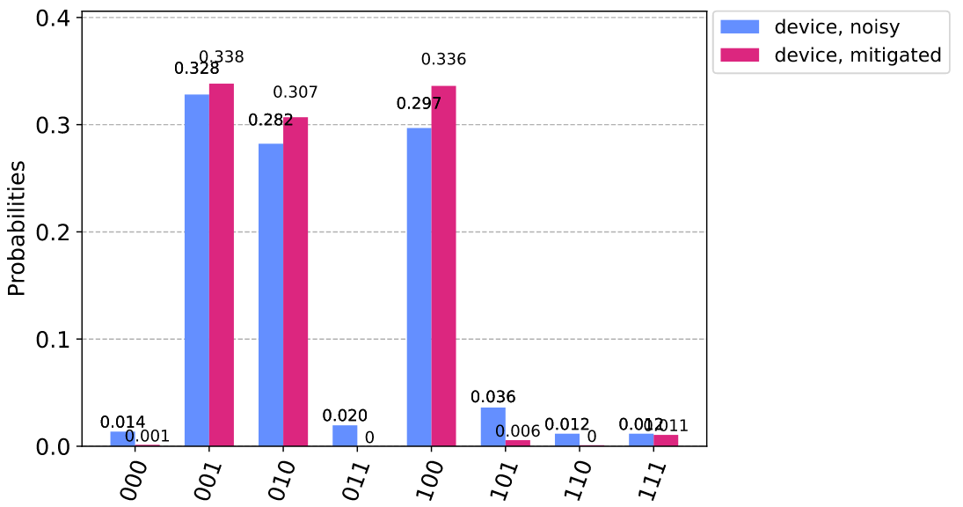
Measurement Error Mitigation in the W-State Quantum Circuit

Slide 8
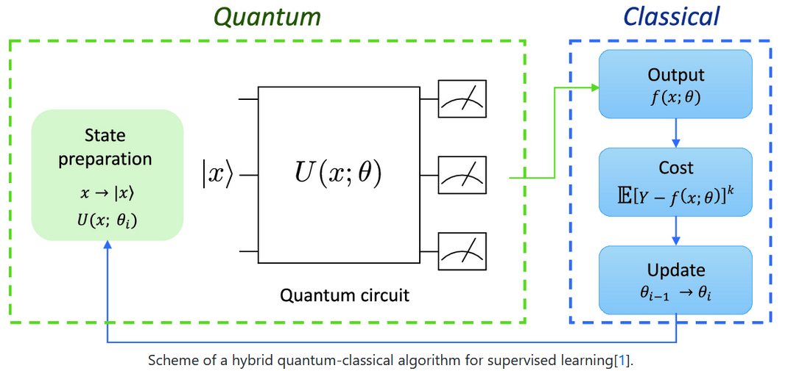
Quantum Machine Learning

Slide 9
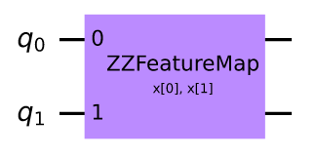
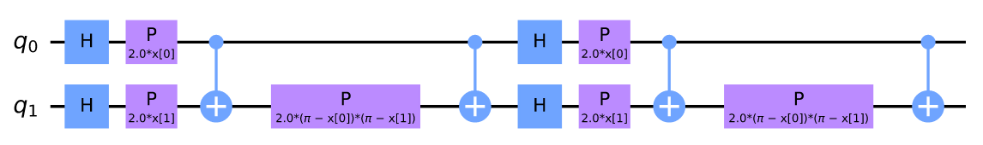
Quantum Machine Learning Feature Map

Slide 10
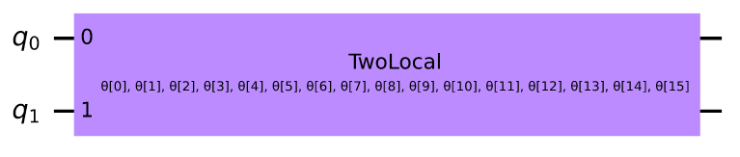
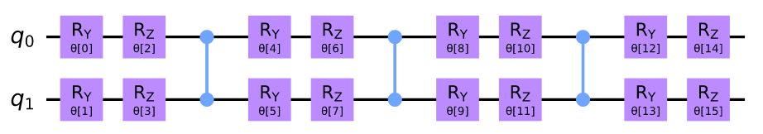
Quantum Machine Learning Ansatz
The ansatz is the first guess. A starting point.
Of course, if the starting point is good, so will the result.

Slide 11
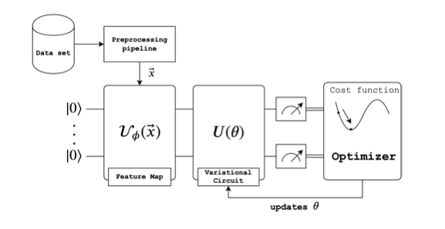
Variational Quantum Classifier (VQC)

